Slide 1
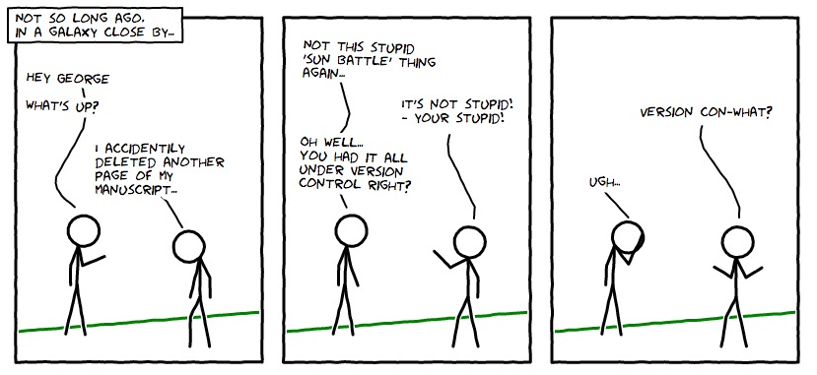
M01 L03
Version Control
and IDE
Version Control Tutorial
teAch Bedeus LLC debmh.teach@gmail.com is licensed under a https://creativecommons.org/licenses/by-nc-sa/4.0/

Slide 2

Today
When have you accomplished something with a little help from your friends?
Check in
Any questions from L02?
Open your participation submission from last class to see comments on your document.
Look at your course grade.
Goals:
Use version control management tools (Git/GitHub) to manage and document development with GitHub Desktop.
Write and debug programs in IDE (Eclipse)
Set up
Sit with someone that is using the same operating system
Open Canvas for this lecture
Open
GitHub Desktop and Eclipse
Eclipse Cheat Sheet - download into repo tech docs folder. I did make some updates if you already downloaded it.
Current Class Grades:
MW: 18 A, 1B, 0C, 7D, 8F
TTh:

Slide 3
Overview creating a program in Java
Set up Project to use correct JDK and store source code
Use editor for source code
Create a .java file
This will contain what we call source code which is your Java code.
Eclipse is the editor - it automatically appends the .java to your source code files
Compile source code
Compiling is done automatically in Eclipse
Compiling source code (.java) generates a .class file - .class file contains the bytecode
Run the .class file
Running means to translate the bytecode into something that the platform understands
Bytecode is executed by the Java Virtual Machine (JVM)
The JVM then either compiles or interprets the bytecode

Slide 4
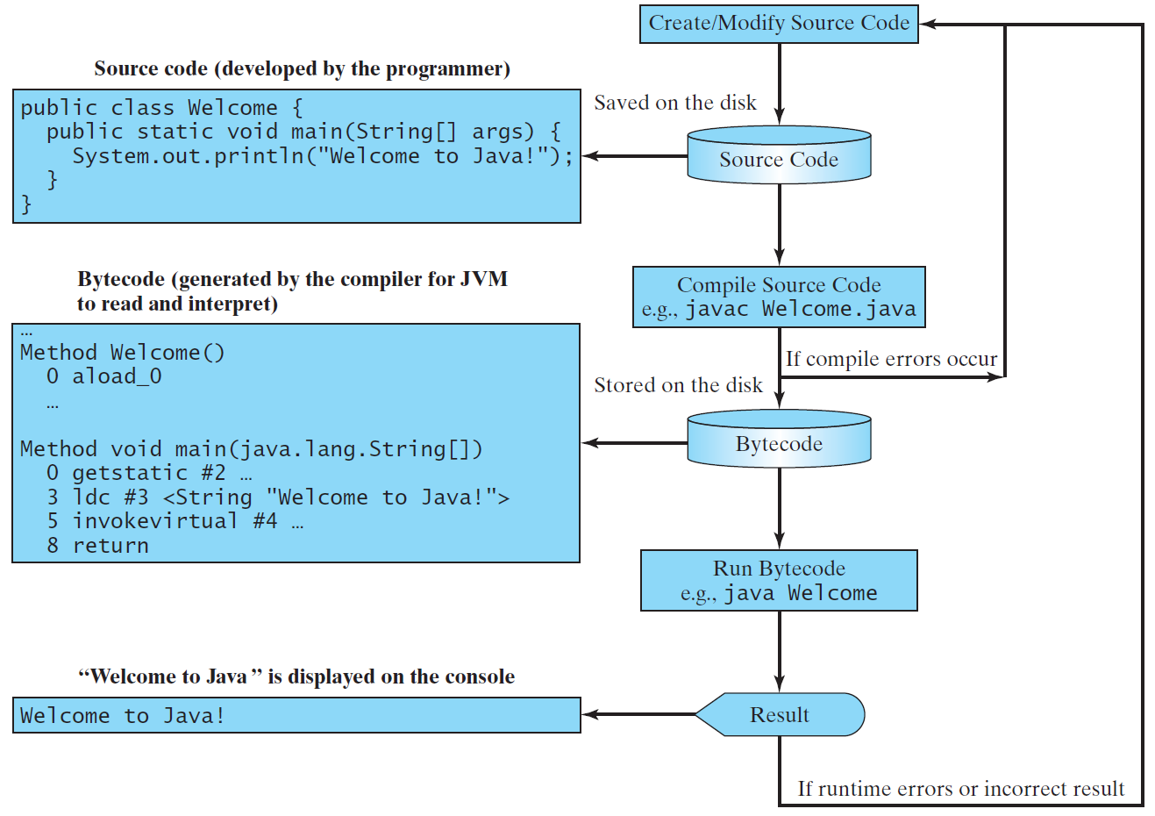
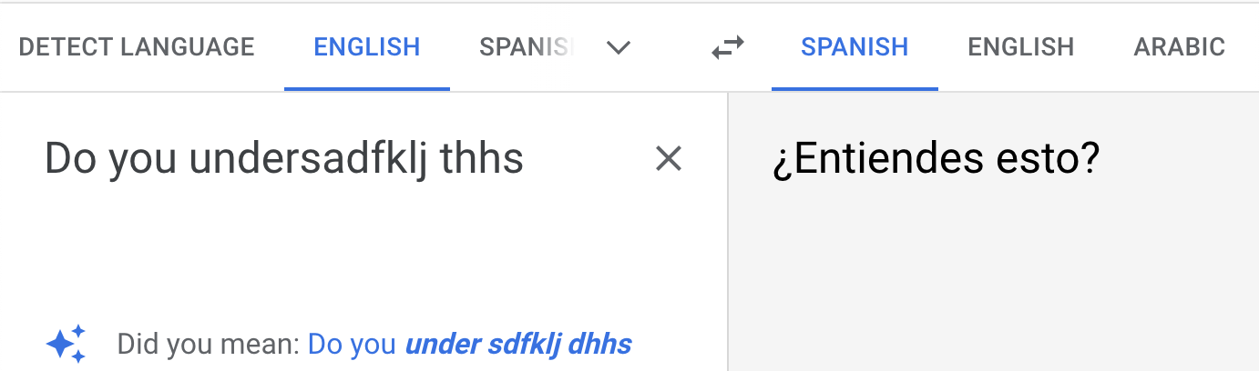
Creating, Compiling and Running Programs

Slide 5
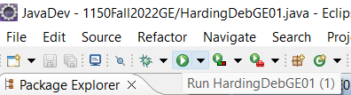
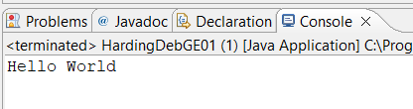
Run
Run means to translate the bytecode into something that the platform understands
Bytecode is executed by the Java Virtual Machine (JVM)
The JVM then either compiles or interprets the bytecode
The program executes the commands.
What can go wrong?

Slide 6
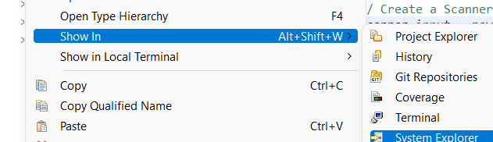
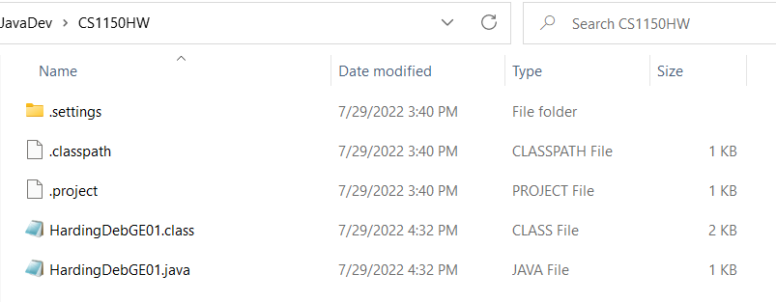
Compile
A compiler translates high-level language into machine language for the computer to read.
Compiling is done automatically in Eclipse
Compiling source code (.java) generates a .class file - .class file contains the bytecode
Right click java file -> Show In -> System Explorer

Slide 7
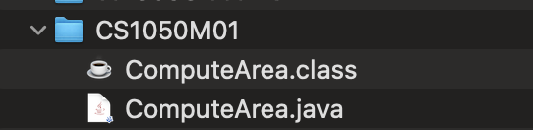
Compile Source Code to Byte Code
A compiler translates high-level language into machine language for the computer to read.
Compiling source code (.java) generates a .class file that contains the bytecode
Byte code instructions are the machine language of the Java Virtual Machine (JVM) and cannot be directly executed by the CPU.
You will turn in the .java source code for your assignments

Slide 8
Environment
If you do not have a laptop in class you will work with someone at the beginning so you know how to do it on your desktop at home.
Computer Science Getting Started
Understanding what you set up and being more efficient with
your operating system
versioning and backing up your work
Writing and debugging code

Slide 9


Explore
Try completing again and see if you understand more than last time
Humans write algorithms to solve tasks and use programming languages to tell the computer how to execute the algorithm.
Use Eclipse (or Go to Visualize Code) select java from the drop down.
Add the following code below println method
Declare integer, identifier test, initialized to 20
Declare double, identifier divResult where is assigned divResult = test/3
Add statement to print divResult
Visualize code
Add another statement divResult = radius/3
Add another statement to print divResult
Visualize code
public class ComputeArea {
public static void main(String[] args) {
double radius; // Declare radius
double area; // Declare area
// Assign a radius
radius = 20;
// Compute area
area = radius * radius * 3.14159;
// Display results
System.out.println("The area for the circle of radius " +
radius + " is " + area);
}
}

Slide 10
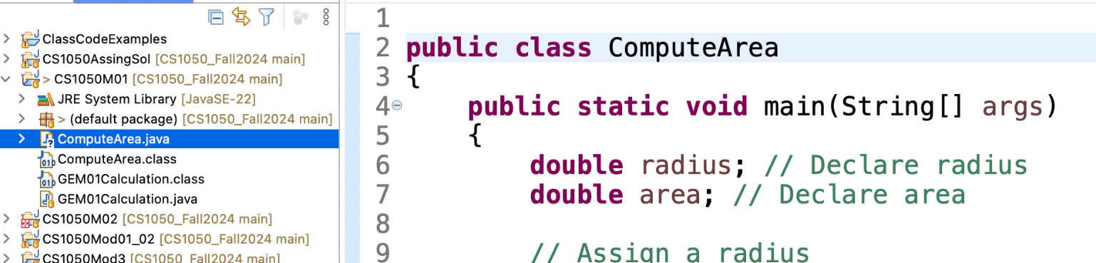
Set Up M01 Project and Class
Use Eclipse Cheat Sheet.
Go slow to go fast - going fast you can make more mistakes and do it over again.
Setup project CS1050M01Fundamentals to store java files from Module 01
Create a class Compute
Go to ComputeArea example and copy the code
Run the code - Does it work?
Open github desktop - what should you do next?
Class name must match filename

Slide 11
Errors
Syntax Errors Animation
When you violate the syntax of the language.
For example, if you leave off a semicolon, have a typo in your code, leave off a curly brace, etc.
Detected by the compiler - shown in Eclipse as a red X – you can hover over the X for information
RuntimeErrors
Occurs when the code is running.
Causes the code to crash - will see error message in console window in Eclipse.
For example, if you attempt to divide by 0 your code will have a runtime error.
ShowLogic Animation
Occurs when your code does not produce the expected result.

Slide 12
Lab: Eclipse and Git/Github
Online GDB if you can’t use eclipse in class. You should have it at home. You can make an account and save in class and then create at home. Let me know if you need help.
GE M01 2.1 Explore GuessNumber Code
Download GuessNumber.java
Open up Eclipse and use Eclipse Cheat Sheet to
Create Project for M01 Code called CS1050M01
Add Existing Java File with Drag and Drop GuessNumber.java CS1050M01 Project
Navigating Java Perspective and Rest Perspective and Views
Edit, Run and Compile
Errors and Warnings and Debug
Debug - Set Breakpoints
Debug - Start Debug Session
Debug - Step Through Code
Add comments to explain constants, variables and naming conventions
Commit to version locally and Push to the GitHub remote server to back up your work.
Create heading to organize information and update technical document
See Preparation in Canvas

Slide 13
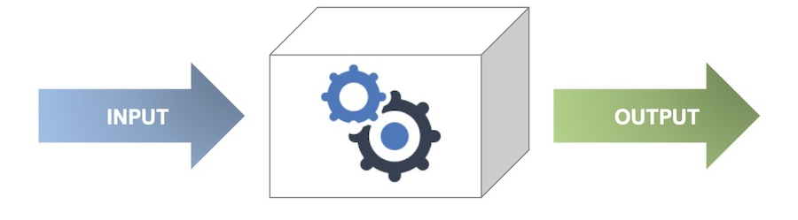

Unit Testing and Test Driven Development (TDD)
Test-Driven Development (TDD): A way of writing software where writing tests come first before the actual code to help you design the algorithm.
These test are used for Unit Testing
A unit test checks one small piece of code (like a method) to make sure it works correctly when you implement code.
Each test has:
Precondition: Input (what you give the method)
Algorithm: Steps to solve problem
Postcondition: Expected Output (what you want back)
Why use TDD and Unit Tests?
Helps you plan your algorithm
Catches mistakes early .
Makes your code more reliable, reusable, and maintainable.
In industry we use these concepts What is Unit Testing? | Agile Alliance and Test Driven Development (TDD)
algorithm
preconditions
postconditions

Slide 14
Lab: GE M01 2.2 Design Calculate Grades
Do you know how to calculate your grade for this class?
On Paper
On Paper Write Test Cases:
Precondition: What do you need to calculate a grade?
Algorithm: What are the steps to calculate grade
Post Condition: What are the expected results
List what you need to stored the information in memory
What should be constants?
What should be variables?
What are the correct naming conventions?
What is the algorithm?
Weights | Example Grade
Class participation 15% | 95
Guided Explorations 20% | 92
Quizzes 25% | 88
Projects 20% | 87
Final Demonstration 20% | 93
Pre-Condition | Algorithm | Post Condition

Slide 15
Preparation
Go to canvas below today’s lecture and last lecture to see what you should be doing. Make time in your calendar to work on what is due next week from this week.
Use lectures 01 and 02 and and the following book sections to help you practice
1.2. Why Programming? Why Java?
1.2.1. First Java Program
1.2.2. Print Commands
1.2.3. Syntax Errors
1.2.4. Debugging Challenge
1.2.5. Comments
1.3. Variables and Data Types
1.3.1. What is a Variable?
1.3.2. Data Types
1.3.3. Declaring Variables in Java
1.3.4. String Concatenation
1.3.5. Naming Variables
1.4. Expressions and Assignment Statements
1.4.1. Assignment Statements
1.4.2. Incrementing the value of a variable
1.4.3. Operators
1.4.4. The Modulo Operator

